Slide 1
Amity Institute of Information Technology
MCA, Semester –I Sem
Advanced Database Management System [IT 601]
By
Dr Ajay Pratap
Assistant Professor (Grade-III)
AIIT, AUUP Lucknow
Notes:
Amity Business School

Slide 2
TOPIC:
Basics of Query Processing
Content Outline:
Definition
Basic Steps in Query Processing
Block Diagram of Query Processing
Detailed Diagram of Query Processing
Parser
Optimizer
Aim of Query Optimization
Execution Engine

Slide 3
Definition:
Query Processing includes translations on high level Queries into low level expressions that can be used at physical level of file system, query optimization and actual execution of query to get the actual result.
Basics Steps in Query Processing:
1. Parsing and translation
2. Optimization
3. Evaluation

Slide 4
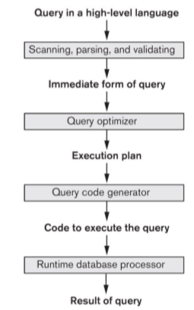
Block Diagram for Query Processing

Slide 5
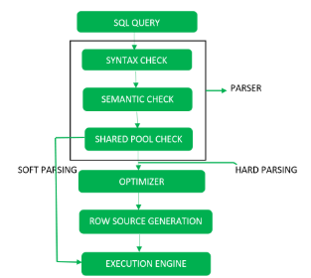
Detailed Diagram for Query Processing

Slide 6
  Step-1: Parser
  During parse call, the database performs the following checks- Syntax check, Semantic check and Shared pool check, after converting the query into relational algebra.
  Parser performs the following checks:
  Syntax check – Concludes SQL syntactic validity.
  Example: SELECT * FORM employee
  Here error of wrong spelling of FROM is given by this check.
  Semantic check – Determines whether the statement is meaningful or not. Example: query contains a tablename which does not exist is checked by this check.

Slide 7
  Step-1: Parser (Cont.)
  Shared Pool check – Every query possess a hash code during its execution. So, this check determines existence of written hash code in shared pool if code exists in shared pool then database will not take additional steps for optimization and execution.
  Note: Hard Parse and Soft Parse –
  If there is a fresh query and its hash code does not exist in shared pool then that query has to pass through from the additional steps known as hard parsing otherwise if hash code exists then query does not passes through additional steps. It just passes directly to execution engine (refer detailed diagram). This is known as soft parsing.

Slide 8
  Step-2: Optimizer
  During optimization stage, database must perform a hard parse at least for one unique DML statement and perform optimization during this parse. This database never optimizes DDL unless it includes a DML component such as subquery that require optimization.
  It is a process in which multiple query execution plan for satisfying a query are examined and most efficient query plan is satisfied for execution.
  Database catalog stores the execution plans and then optimizer passes the lowest cost plan for execution.

Slide 9
Aim of Query Optimization:
Minimization of response time of query (time taken to produce the results to user’s query).
Maximize system throughput (the number of requests that are processed in a given amount of time).
Reduce the amount of memory and storage required for processing.
Increase parallelism.

Slide 10
  Step-3: Execution Engine
  Takes a query-evaluation plan, executes that plan, and returns the answers to the query.

